Slide 1
Machine learning for Bank telemarketing

Slide 2
Metadata of the dataset
THe information
Personal
financial
Previous Campaign
Current Campaign
Bank Telemarketing is a direct marketing method in which a customer is persuaded by the salesperson by phone or a subsequent face to face
The data is related with direct marketing campaigns of a Portuguese banking institution with the binary target whether the customers subscribed a term deposit.
Dataset :
https://archive.ics.uci.edu/ml/datasets/bank+marketing# from the UCI research of [Moro et al., 2014].
Customer’s age, occupation, marital status, and latest education
Customer’s credit card default status, yearly balance, house loaning status, and personal loan
Number of day from previous campaign, number of contact, and campaign status
Communication type, date, duration of contact, number of contact, campaign result

Slide 3
Framing & hypothesis
Here is our heuristic . . .
We want our model to . . .
Our success metric is . . .
the ideal outcome is . . .
The output and it’s usage are . . .
The loyal customer of that bank may subscribe the term of deposit on the campaign. We define the loyal customer as the one who subscribe before
Predict the result of the campaign, whether the customer will subscribe the term deposit after been called
The number of customer that have been called subscribe the term deposit. Success means 70 % of the customers subscribe the term deposit
We want to give a recommendation of which customer to be called so that customer will subscribe the term deposit
Recommendation of customer, which is used for saving bank time, increase chance, and reduce cost

Slide 4
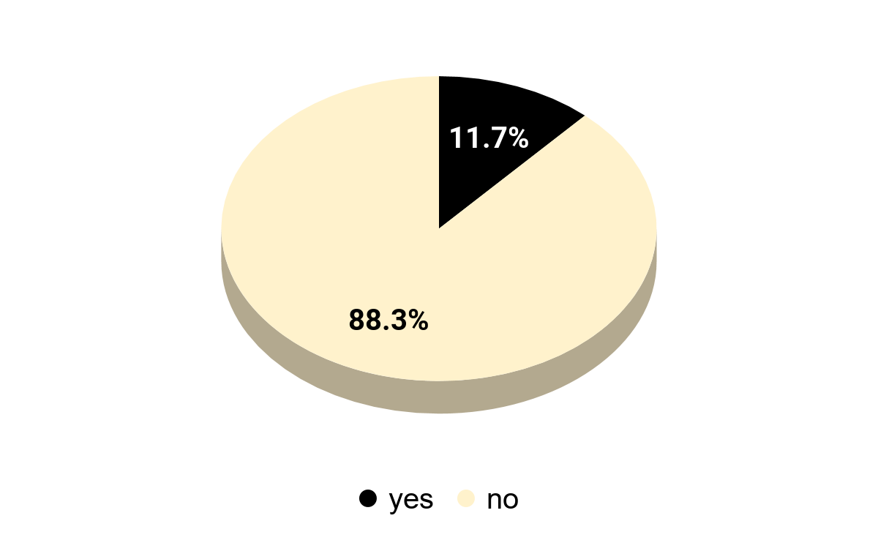
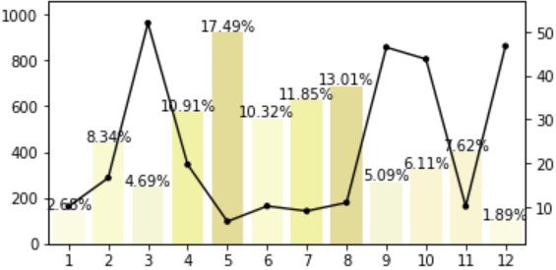
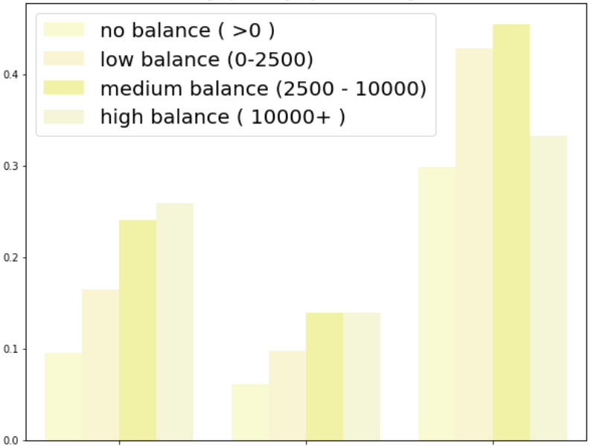
Preparation
Analysis
Proportion of Target
Target % by Month
% by age and balance
Count
Percentage
<30
30-59
59+
Month
Age class
The target is imbalance with 11.7% at the data.
There are a range between month which is the percentage of target is quite low.
Elderly ( 59+ ) has a higher percentage to subscribe than any other classes

Slide 5
Preparation
Analysis
Campaign strategy
Financial
Personal
Previous
Campaign
7 / 10
Avoid using cellular phone, high failure margin.
Success rate depends on duration
Too frequent contact lead to failure
People with debt free have a higher chance than in debt
Management, student, and retired have a higher success rate. While blue lower
Married has a higher rate than single
Primary and secondary tend have a lower success rate. While tertiary higher
Most of people is new to this campaign
Previously accept has a higher chance to accept again
People accept previous term will accept again

Slide 6
Technique
Multilayer perceptron
Architecture
30% test
70% train
Input
Data size
32 Neurons
hyperparameter
16 Neurons
16 Neurons
Output
Input size : sample x 18
Output size : sample x 1
Optimizer : Adam
Learning rate : 0.0004
Loss function : Binary cross-entropy
Metrics : Precision, Recall, and AUC
Epoch : 50

Slide 7
Results & COnclusions
Results & Conclusions
Suggestions
We successfully create a prediction model that predicts 10% of customers will subscribed term deposit, and 40% of them predicted correctly on validation.
Our model is better than calling people randomly with only 11.7% chance of subscribed term deposit.
Our model can be used to saving most of the Bank’s time and cost with more high chance of being a success. We also suggest that:
Make a good relation with people who accept the offer; people who successfully accept an offer previously tend to accept another offer in the future.
Update the model with a new dataset regularly to make sure that the model does not create a bias in the future.

Slide 8
Thank
You
Credit : Slidesgo.com

